Slide 1
Acute infections of the liver: viral hepatitis

Slide 2
Acute hepatitis – acute inflammation of the liver

Slide 3
Objectives
Agents causing liver infections
Spread of liver infections
Signs and symptoms of acute liver infections
Treatment of liver infections
Prevention of liver infections

Slide 4
Acute hepatitis-CAUSES
Drugs and toxins
Infections
  Bacteria: leptospirosis
  Viruses
    Hepatitis (hepatotropic) viruses
    Other viruses: CMV, HSV, EBV, Dengue
Ischaemia
Wilsons diseases

Slide 5
“viral hepatitis” usually refers to hepatitis caused by hepatotropic viruses
Hepatitis A Virus
Hepatitis B Virus
Non-A, Non-B Viruses
  C ,(D),E
  G
Other viruses like Dengue, HSV, CMV, EB virus can also cause an acute hepatitis

Slide 6
CLINICAL FEATURES
Acute hepatitis
Prodromal illness –fever, LOA aches and pains, vomiting (like flu) for about a week
Icteric phase - dark coloured urine, icterus
O/E
  Jaundice
  Tender hepatomegaly
  Splenomegaly (mild) -10%

Slide 7
DIAGNOSIS
Acute hepatitis
Urine bile +, urobilin variable
S. bilirubin raised (mainly direct)
SGPT /SGOT(transaminases) raised to very high levels(Thousands)
Alkaline phosphatase, S. proteins, prothrombin time - normal in uncomplicated hepatitis

Slide 8
VIROLOGICAL DIAGNOSIS
HEPATITIS A
RNA virus
Faecal-oral spread
Mild infection (usually) in childhood. Severe potentially fatal illness in adults
Virological diagnosis
Serum IgM Ab to HAV

Slide 9
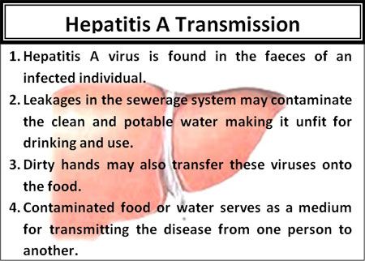

Slide 10
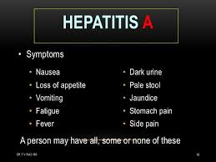

Slide 11
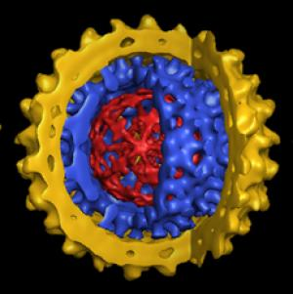
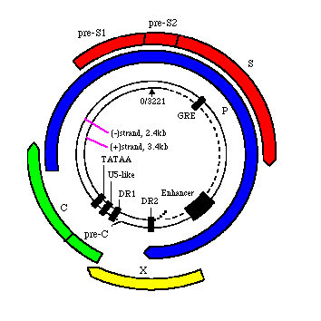
HEPATITIS B

Slide 12
HEPATITIS B
DNA Virus
Long incubation period (50-150 d)
s Ag
e Ag, c Ag, and DNA

Slide 13
Virological diagnosis – acute Hepatitis B infection
HBs Ag +
HBe Ag+
Anti - HBc IgM +
HBV DNA+

Slide 14
SPREAD
Parenteral - blood, blood products, needles and syringes
Sexual - male homosexuals, prostitutes
Vertical - mother to baby at childbirth
Very infective. Speard among family members. Exact mode of transmission not known

Slide 15
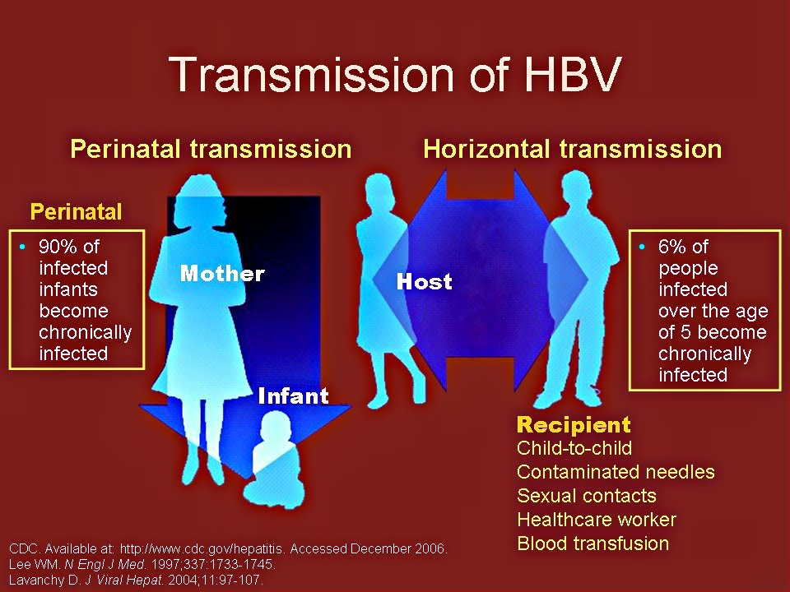

Slide 16
Hepatitis C
  HEPATITIS C VIRUS
  RNA virus
  Spread parenteral, vertical, sexual
  Only rarely causes clinical acute hepatitis
  Virological diagnosis
    Anti - HCV Ab
    HCV - RNA

Slide 17
HEPATITIS E VIRUS
RNA virus
Spread faecal - oral
Clinically resembles HAV infection BUT increases maternal and foetal mortality if acquired during pregnancy
Virological diagnosis
  Anti - HEV Ab (IgM)

Slide 18
COMPLICATIONS
Fulminant hepatic failure - all HV
Cholestatic hepatitis - all HV
Chronic hepatitis - B (5-10%), (D), C (>70%)
Cirrhosis - B, (D), C
Hepatocellular Ca - B, (D), C
‘Asymptomatic carrier’ state - B, C

Slide 19
TREATMENT
Non – specific
Rest (~ duration of icterus)
Hydration
Symptomatic treatment(fever/vomiting)/Nutrition
Avoid alcohol & hepatotoxic drugs
[ Antivirals- acute HBV or HCV in the immuno-compromised]

Slide 20
Specific treatment
Hep A – None
Hepatitis B- Tenefovir
Hepatitis C – Same drugs used in chronic Hep C
Herpes simplex- Acyclovir
CMV hepatitis - Valgancyclovir

Slide 21
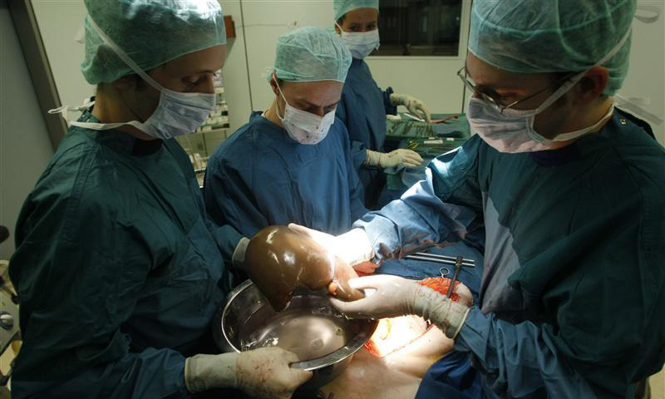

Slide 22
PREVENTION
General measures (reduce risk behaviour)
Vaccines [A ,B, (D)] – not available for C
Passive immunization
  HAV - Pooled Human Ig
  HBV - Hepatitis B Ig

Slide 23
Summary
Viral hepatitis is the most common cause for infections of the liver
Self limiting illness most of the times which only needs supportive care
Prevention by good hygienic practices, safe sex, sterilization techniques and vaccinations when available should be encouraged

